Slide 1

Android Studio
#14
Android Studio
“ RecyclerView, what is it? ”

Slide 2
INNEHÅLLSFÖRTECKNING
01
03
02
04
Översikt
Compose Alternative
RecyclerView
Övningar & Uppgifter

Slide 3
01
ÖVERSIKT

Slide 4

Recycler & List

Slide 5

Recycler
Tillämpa lösningar för större listor.
List för mindre items (enklare uppsättning)
RecyclerView för större listor
(performant friendly)
Compose alternative

Slide 6


Frågor?

Slide 7
02
RecyclerView

Slide 8
What is a RecyclerView?

Slide 9
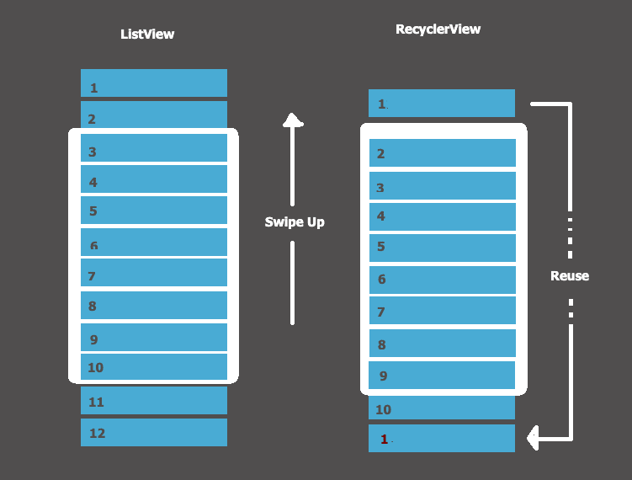

Slide 10
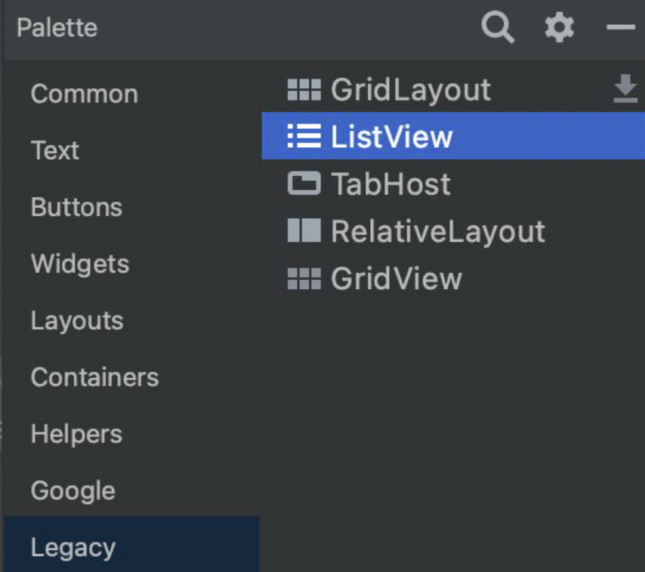
ListView?
Numera anses ListView vara en del av ‘Legacy Code’ och används inte så mycket längre…

Slide 11
How to: RecyclerView

Slide 12
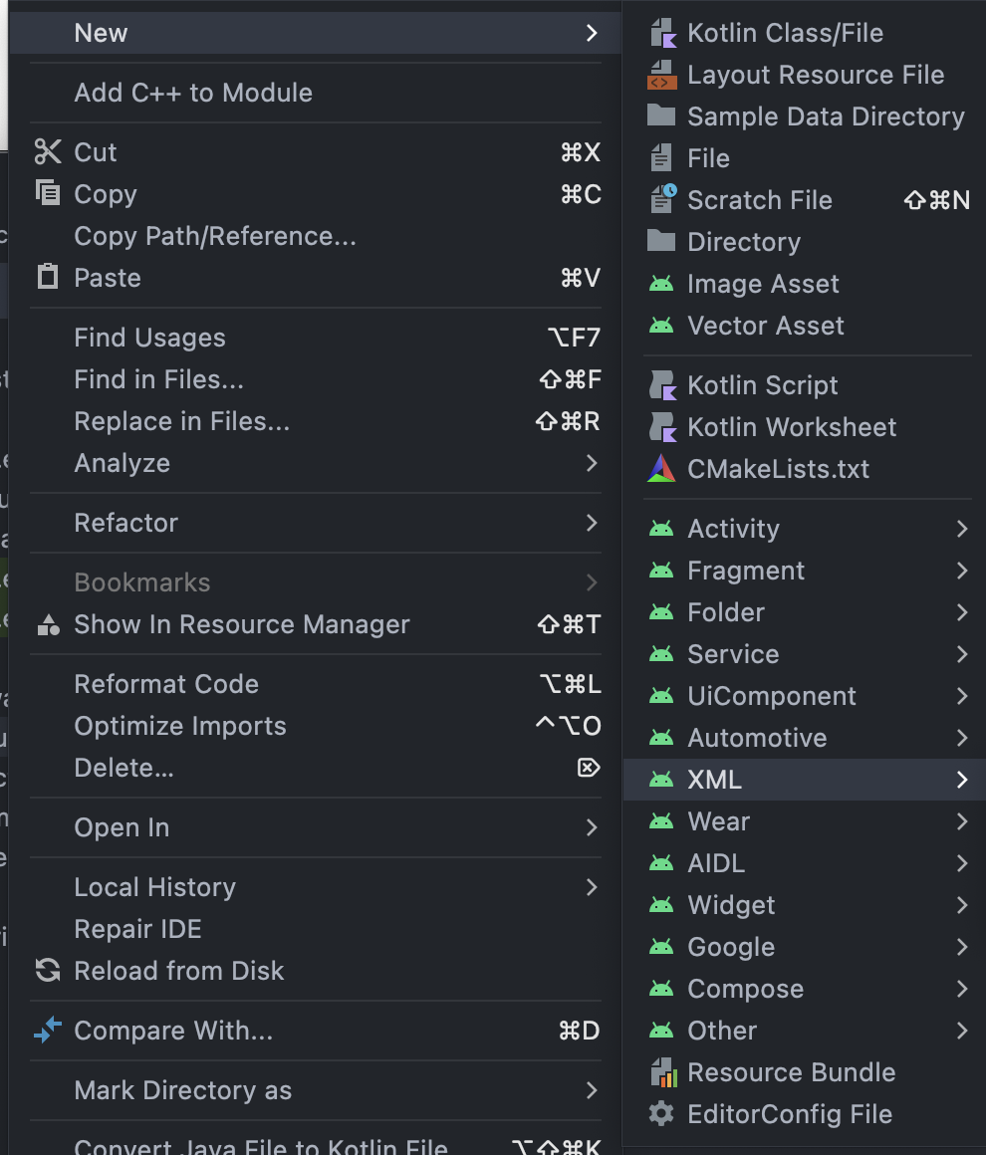
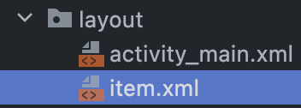
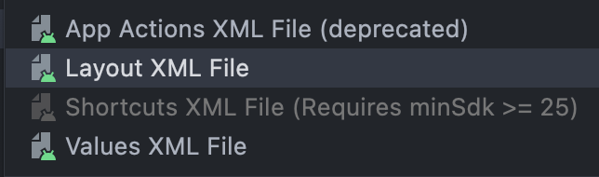
The classes

Slide 13
item.xml
<?xml version="1.0" encoding="utf-8"?>
<LinearLayout xmlns:android="http://schemas.android.com/apk/res/android"
android:layout_width="match_parent"
android:layout_height="match_parent">
<TextView
android:id="@+id/itemTextView"
android:layout_width="wrap_content"
android:layout_height="wrap_content"
android:text="SomeItem"
android:textSize="22sp" />
</LinearLayout>
NOTERA: TextView har ett id “tv_item”
VARNING: Ändra match_parent till ‘wrap_content’ på LinearLayout!

Slide 14
item.xml
<?xml version="1.0" encoding="utf-8"?>
<LinearLayout xmlns:android="http://schemas.android.com/apk/res/android"
android:layout_width="match_parent"
android:layout_height="wrap_content">
<TextView
android:layout_width="wrap_content"
android:layout_height="wrap_content"
android:text="Default Item"
android:layout_marginEnd="12dp"
android:textSize="22sp" />
<LinearLayout
android:layout_width="match_parent"
android:layout_height="match_parent"
android:layout_gravity="end">
<ImageView
android:layout_width="wrap_content"
android:layout_height="wrap_content"
android:maxHeight="45dp"
android:maxWidth="45dp"
android:adjustViewBounds="true"
android:scaleType="fitCenter"
android:src="@drawable/ic_launcher_background"
/>
</LinearLayout>
</LinearLayout>
Copy paste me!

Slide 15
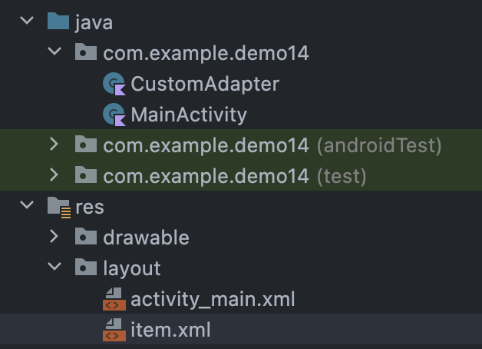
Structure

Slide 16
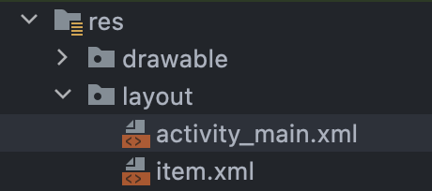
Structure
<?xml version="1.0" encoding="utf-8"?>
<androidx.constraintlayout.widget.ConstraintLayout xmlns:android="http://schemas.android.com/apk/res/android"
xmlns:app="http://schemas.android.com/apk/res-auto"
xmlns:tools="http://schemas.android.com/tools"
android:layout_width="match_parent"
android:layout_height="match_parent"
tools:context=".MainActivity">
<androidx.recyclerview.widget.RecyclerView
android:id="@+id/rv_test"
android:layout_width="409dp"
android:layout_height="354dp"
app:layout_constraintEnd_toEndOf="parent"
app:layout_constraintStart_toStartOf="parent"
app:layout_constraintTop_toTopOf="parent" />
</androidx.constraintlayout.widget.ConstraintLayout>
ID = tv_test

Slide 17
Setup
MainActivity
class MainActivity : AppCompatActivity() {
private lateinit var customAdapter: CustomAdapter
private val itemsList = ArrayList<String>()
override fun onCreate(savedInstanceState: Bundle?) {
super.onCreate(savedInstanceState)
setContentView(R.layout.activity_main)
}
}

Slide 18
Adapter
CustomAdapter
package com.example.demo14
import android.view.View
import android.widget.TextView
import androidx.recyclerview.widget.RecyclerView
internal class CustomAdapter(private var itemsList: List<String>):
RecyclerView.Adapter<CustomAdapter.MyViewHolder>()
{
internal inner class MyViewHolder(view: View) : RecyclerView.ViewHolder(view) {
var itemTextView = view.findViewById<TextView>(R.id.tv_item)
}
}

Slide 19
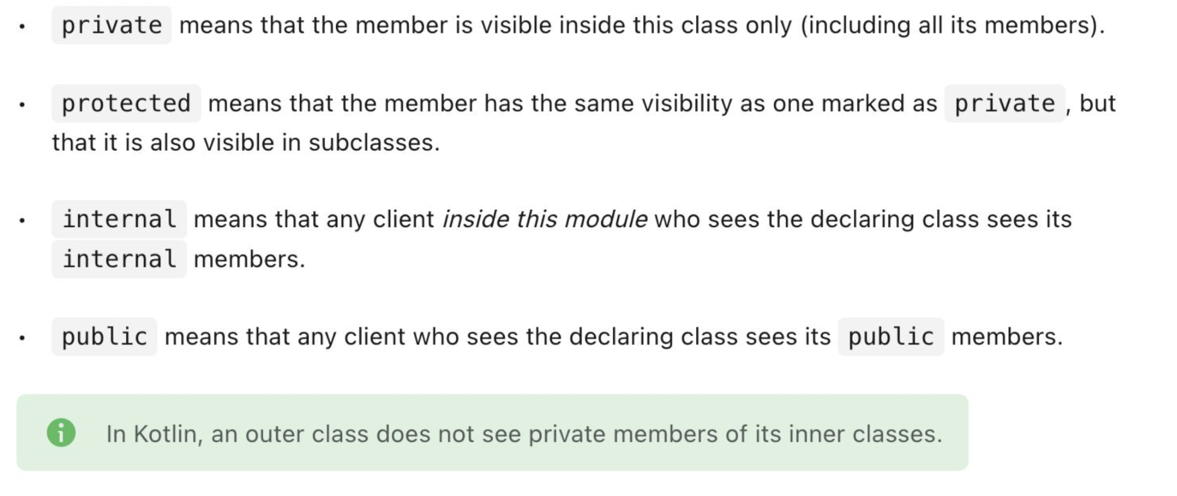
Scope
Source: https://kotlinlang.org/docs/visibility-modifiers.html#class-members

Slide 20
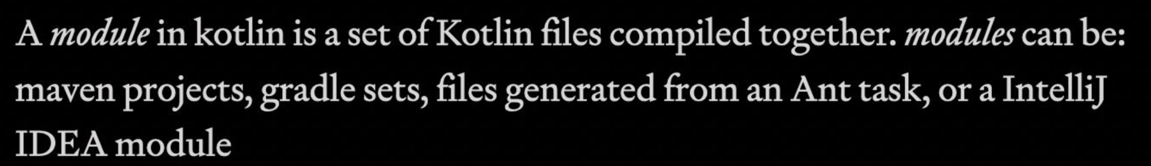
Scope
Source: https://kotlinlang.org/docs/visibility-modifiers.html#class-members

Slide 21
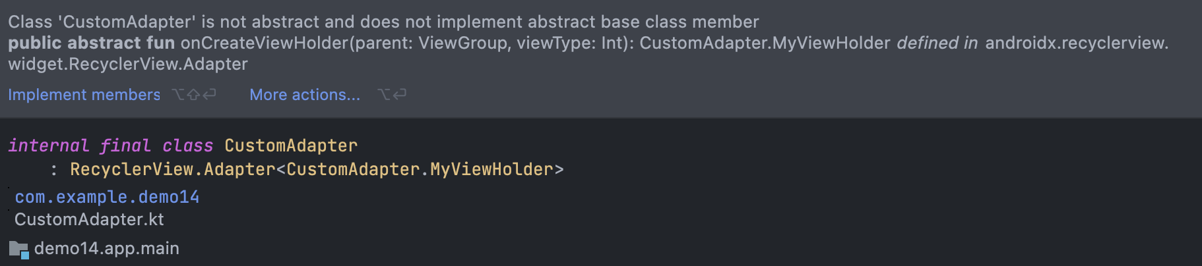
Inheritance
CustomAdapter
package com.example.demo14
import android.view.View
import android.widget.TextView
import androidx.recyclerview.widget.RecyclerView
internal class CustomAdapter(private var itemsList: List<String>):
RecyclerView.Adapter<CustomAdapter.MyViewHolder>()
{
internal inner class MyViewHolder(view: View) : RecyclerView.ViewHolder(view) {
var itemTextView = view.findViewById<TextView>(R.id.tv_item)
}
}

Slide 22
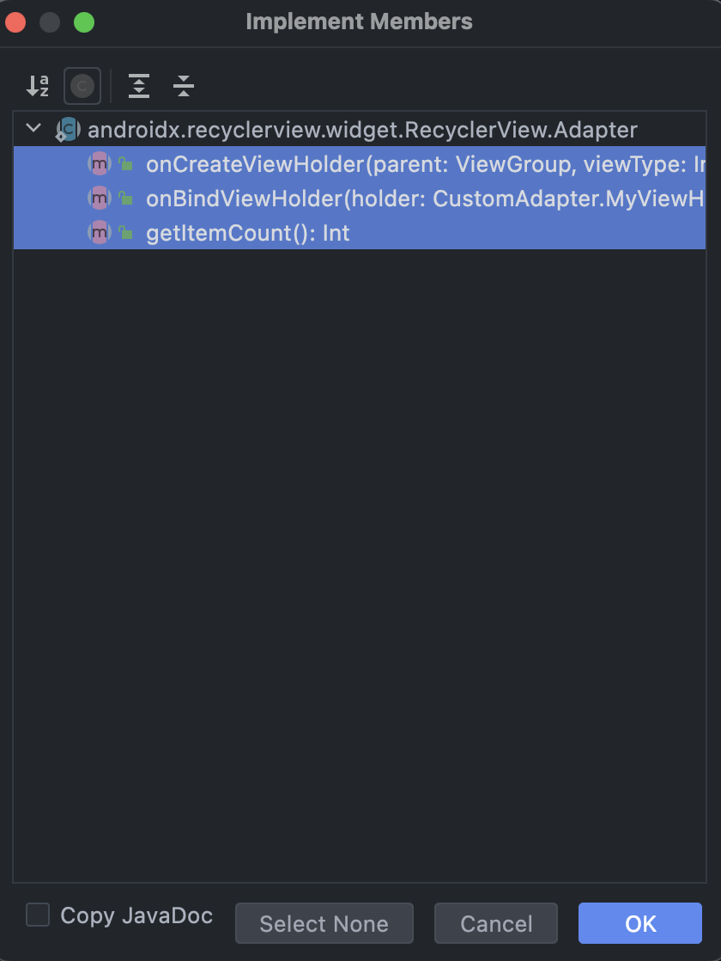
Override!
Markera ALLT - tryck OK

Slide 23
Override
override fun onCreateViewHolder(parent: ViewGroup, viewType: Int): MyViewHolder {
TODO("Not yet implemented")
}
override fun getItemCount(): Int {
TODO("Not yet implemented")
}
override fun onBindViewHolder(holder: MyViewHolder, position: Int) {
TODO("Not yet implemented")
}

Slide 24
Override
override fun onCreateViewHolder(parent: ViewGroup, viewType: Int): MyViewHolder {
val itemView = LayoutInflater.from(parent.context)
.inflate(R.layout.item, parent, false)
return MyViewHolder(itemView)
}
override fun getItemCount(): Int {
return itemsList.size
}
override fun onBindViewHolder(holder: MyViewHolder, position: Int) {
val item = itemsList[position]
holder.itemTextView.text = item
}

Slide 25

ActivityMain
// Setup RecyclerView
val recyclerView: RecyclerView = findViewById(R.id.rv_test)
customAdapter = CustomAdapter(itemsList)
val layoutManager = LinearLayoutManager(applicationContext)
recyclerView.layoutManager = layoutManager
recyclerView.adapter = customAdapter
prepareItems() // We define this on the next slide

Slide 26
Override
private fun prepareItems() {
for (i in 1..1000) {
itemsList.add("Item $i")
}
customAdapter.notifyItemRangeInserted(1, 1000)
}
Det är viktigt att när ni är klara med att lägga till items, att notifiera förändringarna.
Gör vi inte det, så kan konstiga saker hända och det finns en risk att listan inte uppdateras korrekt.

Slide 27
OnClick!
CustomAdapter
var onItemClick: ((String) -> Unit)? = null // BoilerPLate
internal inner class MyViewHolder(view: View) : RecyclerView.ViewHolder(view) {
var itemTextView: TextView = view.findViewById(R.id.tv_score)
// Have more TextViews? Define them here!
// Define OnCLick
init {
view.setOnClickListener {
onItemClick?.invoke(itemsList[adapterPosition])
}
}
}

Slide 28
OnClick!
Main Activity
// onItemClick
adapter.onItemClick = {
Toast.makeText(applicationContext, "Score was: $it", Toast.LENGTH_LONG).show()
}

Slide 29
03
Compose Alternative

Slide 30
Lazy!

Slide 31
That’s all…
@Composable
fun MyScreen() {
val itemsArray = arrayOf("Item 1", "Item 2", "Item 3", "Item 4", "Item 5")
val selectedItemIndexState = remember { mutableStateOf(0) }
LazyColumn {
items(itemsArray) { item ->
Text(
text = item,
modifier = Modifier
.fillMaxWidth()
.clickable {
selectedItemIndexState.value = itemsArray.indexOf(item)
println("Item $selectedItemIndexState")
}
.padding(16.dp)
)
}
}
}

Slide 32
04
Övningar
&
Uppgifter

Slide 33
MINNS DU?
// Vad är en ListView?
// Hur jämför sig en RecyclerView mot en ListView?
Vilket är att föredra?
// Hur fungerar en RecyclerView?

Slide 34
THANKS!
Do you have any questions?
kristoffer.johansson@sti.se
sti.learning.nu/
You can also contact me VIA Teams (quicker response) Du kan också kontakta mig VIA Teams (Snabbare svar)

